Slide 1

The Nelson Mandela African Institution of Science and Technology
Course Name: Research Methods and
Communication
Course Code: 6001
(Lecturer: Elizabeth Mkoba, PhD)
Learning Unit 2: Literature Review

Slide 2
Read This Slowly by Jakewoodard
“The Universe responds to your frequency. It does not recognize your personal desires, wants or needs. It only understands the frequency in which you are vibrating at.
For example,
If you are vibrating in the frequency of fear, guilt or shame, you are going to attract things of similar vibration to support that frequency.
If you are vibrating in the frequency of love, joy and abundance, you are going to attract things to support that frequency.
It is like tuning into a radio station. You have to be tuned into the radio station you want to listen to just like you have to be tuned into energy you want to manifest in your life”.

Slide 3
LEARNING OUTCOMES
Students should be able to:
Explain reasons of reviewing literature;
Describe sources of data;
Describe your plan of literature review;
Describe the recording of literature;
Describe Definition of Key Terms;
Explain Theoretical Literature Review;
Explain Empirical Literature Review;
Describe Research Gap;
Describe a conceptual framework and its components;
Formulate Hypotheses

Slide 4
LEARNING UNIT 2 ASSESSMENT CRITERIA
Students should be able to:
Understood reasons of reviewing literature;
Understood sources of data;
Understood how to plan for literature review;
Understood the recording of literature;
Understood Definition of Key Terms;
Understood Theoretical Literature Review;
Understood Empirical Literature Review;
Understood Research Gap;
Understood a conceptual framework and its components;
Understood how to formulate Hypotheses

Slide 5
Literature Review
This is the process of searching the existing literature relating to your research problem to develop theoretical and conceptual frameworks for your study and to integrate your research findings with what the literature says about them.
In addition the process helps you to improve your research methodology.

Slide 6
Literature Review …
There are steps involved in conducting a literature review:
Searching for the existing literature in your area of study.
Reviewing the selected literature.
Developing a theoretical framework.
Developing a conceptual framework.
Formulating Hypotheses.

Slide 7
1. Reasons for Reviewing Literature…
Preliminary search to help generate and refine research ideas.
Demonstrate awareness of the current state of knowledge in your subject, its limitations and how your research fits in this wider context.
To help refine research questions and objectives.
To highlight research possibilities that have been overlooked implicitly in research to date.
To discover explicit recommendations for further research (justification of your research)

Slide 8
1. Reasons for Reviewing Literature …
To help avoid simply repeating work that has been done already.
To sample current opinion on the topic in related works giving insights into aspects of research questions/objectives considered newsworthy.
To discover and provide an insight into research strategies and methodologies that may be appropriate to research.

Slide 9
1. Reasons for Reviewing Literature …
In literature review ask these questions:
What's been done in this topic area to date? What are the significant discoveries, key concepts, arguments, and/or theories that scholars have put forward? Which are the important works?
On which particular areas of the topic has previous research concentrated? Have there been developments over time? What methodologies have been used?
Are there any gaps in the research? Are there areas that haven't been looked at closely yet, but which should be? Are there new ways of looking at the topic?
Are there improved methodologies for researching this subject?
What future directions should research in this subject take?
How will your research build on or depart from current and previous research on the topic? What contribution will your research make to the field?

Slide 10
1. Reasons for Reviewing Literature …
In reviewing the literature you will therefore need :
To include the key academic theories within your chosen area.
To demonstrate that your knowledge of the chosen area is up to date.
To show how your research relates to previously published research.
To assess the strengths and weaknesses of previous works including omissions or bias and take them into account.
To justify your arguments by referencing to various works
Through clear referencing, to enable readers to find the original work you cite.

Slide 11
2. Sources of Literature
Identify the sources of the related works from:
Databases such as IEEE Xplore, SCOPUS, ScienceDirect, SpringerLink, ACM, Google Scholar,
Technical Reports,
Previous Dissertations (library repositories, www.proquest.com),
Previous Project Reports,
Websites, National Research repositories etc.

Slide 12
3. Planning of Literature Review
Search string:
Step 1: Identify keywords to include in your search string.
Consider your research questions and objectives e.g. What are the organisational culture attributes that influence the adoption of agile practices?
Step 2: Create a search string using the keywords from step1 and Boolean operators.
((“Organisational culture” OR “organisational culture” OR “Organisation culture” OR “organisation culture”) AND (“cultural” OR “culture”) AND (“adoption”) AND (“Agile practices” OR “Agile practice” OR “Agile methods” OR “Agile method” OR “Agile methodologies” OR “Agile methodology” OR “Agile principle” OR “Agile principles” OR “Agile processes” OR “Agile process”)).

Slide 13
3. Planning of Literature Review …
Use inclusion criteria to reduce the number of studies by selecting the ones focusing on the purpose of the study.
The Inclusion criteria:
Abstract/ Title/Full text: Relevance to research question
Date of publication: 2018-2022
Language: Papers written in English
Type of publications: Peer-reviewed journals, books
chapters, conference and books
Research method: Qualitative, quantitative, mixed method
Geographic location: Worldwide

Slide 14

4. Recording the Literature
Journals | Books | Chapters in an edited book
Author (s) Surname, initials | -do- | -do-
Year of publication ( ) | -do- | -do-
Title of journal | Title and subtitle of book | Title of chapter
Volume | Edition | Author (s) of book: surname, initials
Part/issue | Place of publication | Title and subtitle of book
Page numbers preceded by p or pp | Publisher | Edition
 |  | Place of publication
 |  | Publisher
 |  | Page number of chapter

Slide 15
5. Definition of Key Terms (if any)
Artificial intelligence (AI) is the study and creation of computer systems that perform activities that would normally require human ability, such as sight, voice recognition, decision-making, and language processing (Dictionary, 2017).
Machine learning is the application and development of computer systems that are able adjust without specific guidelines by studying and inferring from patterns in data using various algorithms methods (Lexico, n.d.).
Deep learning is a machine learning and artificial intelligence (AI) technique that mimics how people acquire particular forms of knowledge (Artem Oppermann, 2019).
Computer vision is a branch of artificial intelligence (AI) that allows users and systems to extract useful data from online photos, videos, as well as other sensory inputs and act or offer suggestions based on those facts (Engn & Fletcher, 2003).

Slide 16
6. Theoretical Literature Review
This will be the review of literature on the theory or theories, which the student will have identified as being the guiding principle of the study (i.e. theory (ies) guiding the study).
How the theory (ies) has been used by other researchers and how it will be used in the study has to be highlighted and analytically evaluated. By definition, a theory is a set of concepts and therefore some of the concepts in the conceptual framework may be identified from these theories.

Slide 17
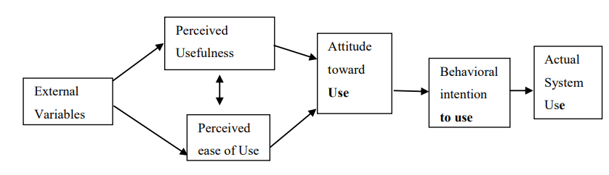
6. Theoretical Literature Review
2.2.1 Technology Acceptance Model
2.2.2 Diffussion of Innovation Theory: Explains the rate at which consumers will adopt a new product or service.
2.2.3 Theory of Planned Behaviour: Is a psychological theory that links beliefs to behavior. The theory maintains that three core components, namely, attitude, subjective norms, and perceived behavioral control, together shape an individual's behavioral intentions.
2.2.4 Any other theory specific to your area of study
** Adopt theory (ies) to guide your study and provide justification of choosing them.

Slide 18
7. Empirical Literature Review …
Identify the sources of the related works (databases such as IEEE, SCOPUS, ScienceDirect, Springer, ACM, Google Scholar, Reports, Previous Dissertations/Project Reports, Websites etc.)
Prepare your own working with summary of the related works (will help to identify research gap).
Research Gap: Explain a technical research gap to address in your study.
Reference | Problem addressed | Proposed solution | Technology used | Limitation of the Study

Slide 19
8. Conceptual Framework
Concept:
Conceptual frameworks can act like maps that give coherence to empirical inquiry. Because conceptual frameworks are potentially so close to empirical inquiry, they take different forms depending upon the research question or problem.
A conceptual framework is the researcher’s own position on the problem and gives direction to the study. It may be an adaptation of a model used in a previous study, with modifications to suit the inquiry.
Aside from showing the direction of the study, through the conceptual framework, the researcher can be able to show the relationships of the different constructs that he wants to investigate.

Slide 20
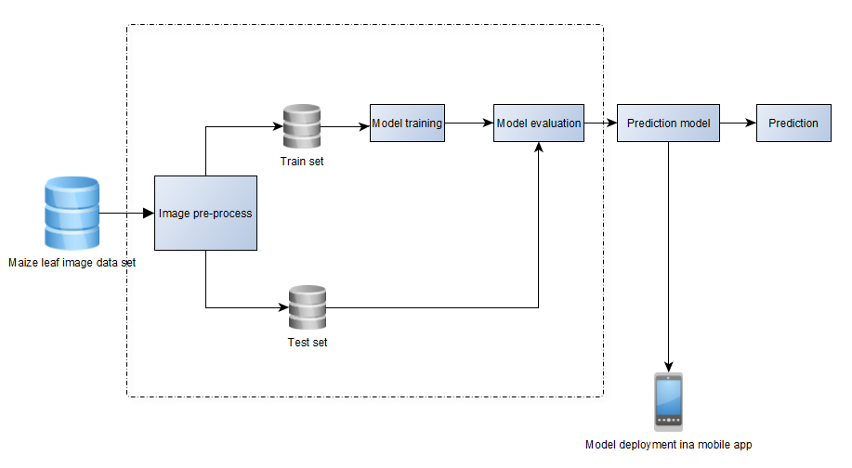
8. Conceptual Framework …
Example 1

Slide 21
8. Conceptual Framework …
Describe components of your framework (e.g.)
Component 1
Component 2
Component 3

Slide 22
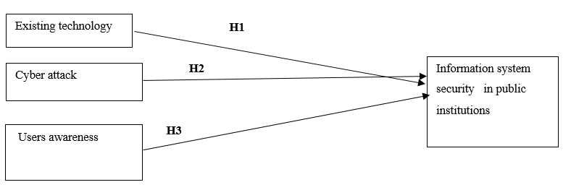
8. Conceptual Framework …
Example 2

Slide 23
9. Hypotheses Formulation
What is a null and alternate hypothesis?
Null Hypothesis: Null hypothesis is the hypothesis, which is to be actually tested. E.g. H1a₀
A Null Hypothesis is a statement, in which there is no relationship between two variables
Alternate Hypothesis: Whereas alternative hypothesis gives an alternative to the null hypothesis. E.g. H1a₁
Alternate Hypothesis: An alternative hypothesis is statement in which there is some statistical significance between two measured phenomenon.
e.g. Statistical test has to be done such as ANOVA to obtain p-value.

Slide 24
9. Hypotheses Formulation …
From the conceptual framework and Literature review, the following Hypothesis will be formulated
9.1 Existing Technology
Explanation about existing technology with references.
H1a₀: Existing Technology does not significantly have effect on the Information security in Public Organization
H1a₁: Existing Technology significantly have effect on the Information security in Public Organization

Slide 25
9. Hypotheses Formulation …
From the conceptual framework and Literature review, the following Hypothesis will be formulated
9.2 Cyber Security attacks
Explanation about cyber security attacks with references.
H2a₀: Cyber security attack does not significantly have effect on the Information security in Public Organization
H2a₁: S Cyber security attack significantly have effect on the Information security in Public Organization

Slide 26
9. Hypotheses Formulation …
From the conceptual framework and Literature review, the following Hypothesis will be formulated
9.3 Users awareness
Explanation about user awareness with references.
H3a₀: Users awareness significantly have no effect on the Information security in Public Organization
H3a₁: Users awareness significantly have effect on the Information security in Public Organization

Slide 27
Contents of Literature Review Chapter
2. Literature review
2.1 Introduction
2.2 Definition of Key Terms (if any)
2.3 Theoretical Literature Review
2.4 Empirical Literature Review
2.5 Research Gap
2.5 Conceptual Framework
2.5.1 Description of the conceptual framework
2.6 Hypotheses Formulation
2.6.1 Hypothesis 1
2.6.2 Hypothesis 2 …

Slide 28

…End…

